Slide 1


S
Department of BES-1
DaTA STRUCTUREs using python
Topic:
Bucket sort & EXTERNAL SORTING demonstration

Slide 2



AIM OF THE SESSION
To familiarize students with the basic concept that student should learn regarding External Sorting Algorithm and its Time complexity.
INSTRUCTIONAL OBJECTIVES
This Session is designed to:
Demonstrate :- External Sorting Methodology
Describe :- External Sorting Algorithm
List out the :- Advantages and applications of External Sort Algorithm
Describe the :- Time complexity of External Sort Algorithm.
LEARNING OUTCOMES
At the end of this session, you should be able to:
Define :- Analysis of the algorithm.
Describe :- Time complexity.
Summarize:- Various Advantages and Applications

Slide 3
Algorithm Analysis
External Sorting is applied on data set which acquire large memory which cannot be holded in main memory (RAM) and is stored in secondary memory ( hard disk).
External merge sort uses a hybrid sort-merge technique.
The chunks of data small enough to fit in the RAM are read, sorted, and written out to a temporary file during the sorting phase.
In the merge phase, the sorted sub-files are combined into a single larger file.

Slide 4
External Sort Approach
The idea of sorting used in external sort is quite similar to merge sort. In also possess two phases like in merge sort
In the sort phase, small memory size data sets are sorted and then in merge phase, these are combined to a single dataset.
For a huge data set which cannot be processed in a single go. Data is divided into small chunks. These chunks are sorted and then stored in data files.

Slide 5
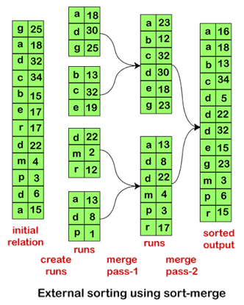
External Sort

Slide 6
Algorithm
Read the input data from the file and input it as data sets of size of memory.
2. For each of these mini data sets sorted each of them using merge sort.
3. Store the sorted data into a file.
4. Merge each of the sorted data file

Slide 7
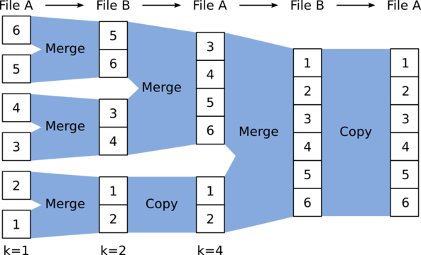
Example

Slide 8
Time Complexity
Time Complexity: O(N * log N).
Time taken for External sort is O(runs * run_size * log run_size), which is equal to O(N log run_size).
To merge the sorted arrays the time complexity is O(N * log runs).
Therefore, the overall time complexity is O(N * log run_size + N * log runs).
Since log run_size + log runs = log run_size*runs = log N, the result time complexity will be O(N * log N).
Auxiliary space: O(run_size). run_size is the space needed to store the array.

Slide 9
SUMMARY
External merge sort uses a hybrid sort-merge technique.
The chunks of data small enough to fit in the RAM are read, sorted, and written out to a temporary file during the sorting phase.
In the merge phase, the sorted sub-files are combined into a single larger file.

Slide 10
SELF-ASSESSMENT QUESTIONS
External-sort merge algorithm is called an ___ because it merges N runs.
One-way
Two-Way
N-Way
Null-Way
There will either be M or more runs generated depending on the size of the ___.
Relation
Memory
Both a and b
None of the above

Slide 11
TERMINAL QUESTIONS
1. Describe External Sorting Algorithm.
2. List out Advantages and applications of External Sort Algorithm.
3. Analyze Time complexity of External Sort Algorithm.
4. Summarize External Sort Algorithm.

Slide 12
REFERENCES FOR FURTHER LEARNING OF THE SESSION
Textbooks: Mark Allen Weiss, Data Structures and Algorithm Analysis in C, 2010, Second Edition, Pearson Education. Allen B. Downey, ”Think Python: How to Think Like a Computer Scientist’’, 2nd edition, Updated for Python 3, Shroff/O’Reilly Publishers, 2016 (http://greenteapress.com/wp/thinkpython/) Data Structures and algorithms using python, 2011,Rance D, Necaise, himilton printing
ReferenceBooks: Data Structures and Algorithm Analysis in PYTHON, 2010, Mark Allen Weiss, Second Edition, Pearson Education. Data Structures and Algorithms, A.V.Aho, J.E.Hopcroft, and J.D.Ullman, Pearson Education, First Edition Reprint2003. Advanced Guide to Python 3 Programming, John Hunt, 4th Edition, Springer Nature Switzerland AG 2019. Python Basics: A Practice Introduction to Python 3, David Amos, Dan Bader, Joanna Jablonski, Fletcher Heisler, 4th edition, Real Python.
WebLinks: https://docs.python.org/3/tutorial/datastructures.html https://www.w3schools.com/dsa/dsa_intro.php https://www.geeksforgeeks.org/python-data-structures/

Slide 13
THANK YOU
C01 – DATA STRUCTURES USING PYTHON

